Slide 1
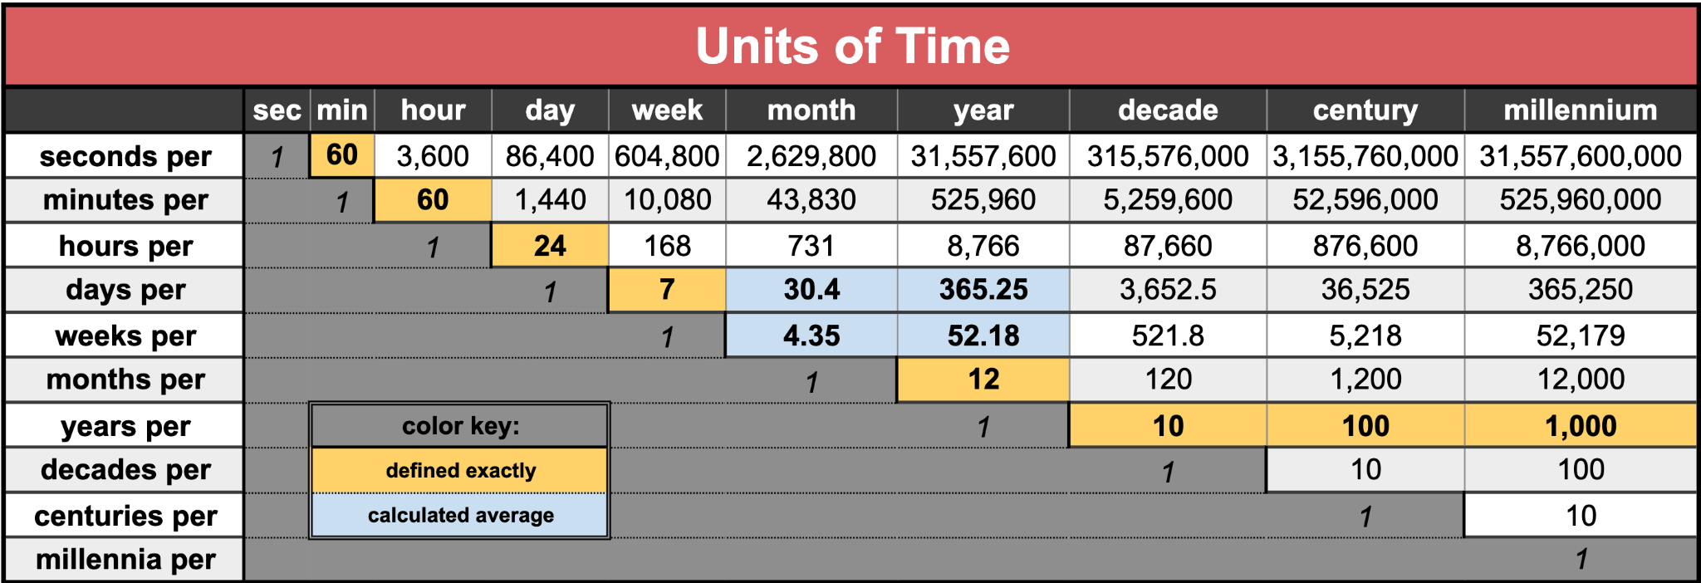
How old are you?
Use at least two different units of time.

Slide 2
Units of Time Taboo
Clue-givers stand up. Guessers may also stand up.
Use clues to get your partner or teammates to guess the word at the top of the slide WITHOUT using any of the red words below. (You also may not say the word at the top of the card.)
When your team guesses correctly, sit down.
If your clue-giver uses a ‘taboo’ clue, then your team sits down.
Notes:
Seconds
Season
Hour
Decade
Month Year

Slide 3
seconds
fast
sixty
minute
first

Slide 4
season
winter
four
summer
spring

Slide 5
hour
day
minute
60
24

Slide 6
decade
years
10
nineties
2020’s

Slide 7
months
days
twelve
year
January

Slide 8
week
52
four
seven
Monday

Slide 9
year
birthday
sun
365
leap

Slide 10
millenium
1000 years
Century
Eon
Future
2000s

Slide 11
fortnight
Two weeks
14 days
Bi-weekly
Moon
Vacation

